Slide 1
Introduction to Intelligent, Knowledge-Based, and Cognitive Systems
Finale project Class Presentation
Shaked Hiba

Slide 2
Core concepts
Start going through the environment and record what you see on the way to the goal
Start with an optimistic representation of the world(meaning all transition are possible and all rewards are maximal)
Once we have seen an action enough we mark it as known
Note- we keep on recording the states and transitions

Slide 3
?How To Choose
Fast-forward lookahead into the near future for an action the will have maximum overall reward estimation
For each transaction –
If marked as known – give maximum reward and transition probability of 1
If marked as unknown – estimate the reward as the average of previous rewards and transition probability as seen also
Weigh the rewards for each transaction according to transition probability

Slide 4
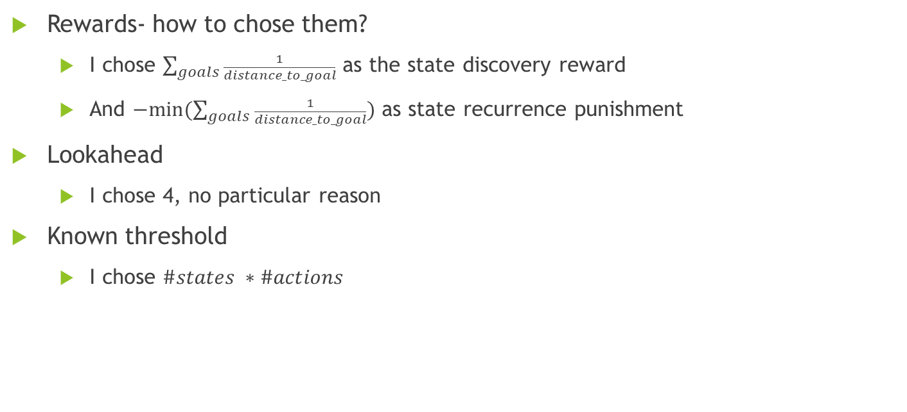
Setbacks

Slide 5
Possible addons
Once all transitions for an environment are marked as known- plan for best course
Limit the round time
Reward successful routes

